Slide 1
Year 6 Lledr Hall visit
Class 6JW from Monday 3rd June to Wednesday 5th June 2024
Class 6SG from Wednesday 5th June to Friday 7th June 2024

Slide 2
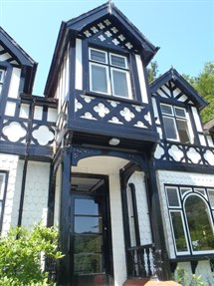
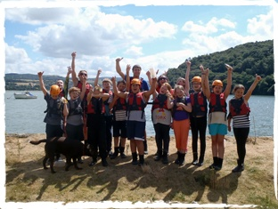
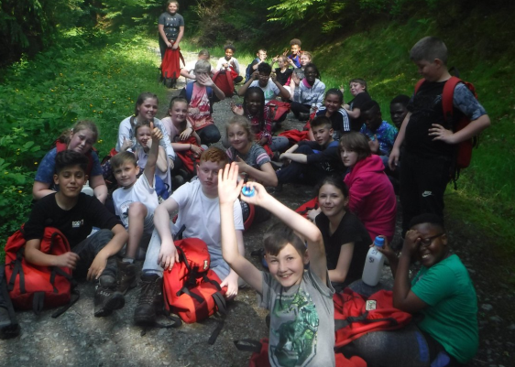
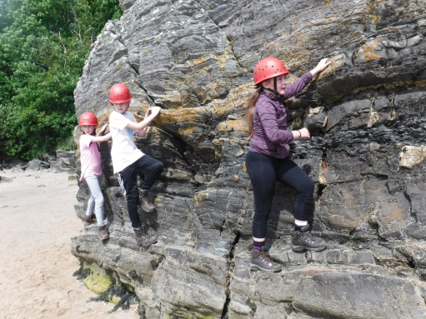
Introduction
Lledr Hall has been a Salford establishment for almost 40 years and in that time tens of thousands of Salford people have visited, you may even know someone who has been there or been there yourself!
It is located in Pont y Pant, Dolwyddelan the heart of the Snowdonia National Park with the mountains, rivers and lakes on its’ doorstep. It is the perfect location for exploring and having adventures in the great outdoors.
It offers a wide range of activities from ropes courses and canoeing on-site to climbing, riding bikes through the forests and scaling gorges with dramatic waterfalls. Throughout all these adventures the children will be safely led by a highly experienced staff team that have years of experience and all the qualifications in this specialised area of teaching.
Our aim is for every child to enjoy their time and to go away with lots of fantastic memories that will stay with them for the rest of their lives.

Slide 3
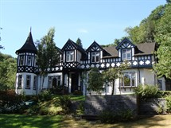
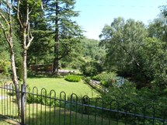
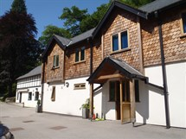
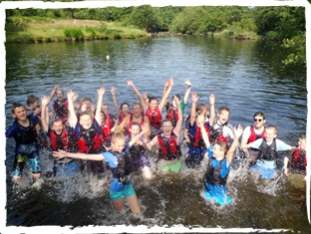
Taking part in the well led and carefully managed adventurous activities promotes increased self-confidence, motivation and independence. On all of the activities, the children work together with others, improving their teamwork skills, to achieve success. This success demonstrates first-hand the benefits that come from working with others to achieve shared goals.
The grounds of the Centre itself extend to over 12 acres and include lawn, garden and mature woodland all bounded by the stunning river Lledr. In the grounds there is a range of activities including low and high level ropes courses, orienteering courses, a canoeing and kayaking pool and even Lledr’s very own gorge walk. These on-site activities provide the perfect environment to introduce the skills and attributes that enable students to progress out into the surrounding countryside to enjoy adventures in the mountains.
Every aspect of what the children do has been checked and the level of risk is controlled and the children will have been well prepared and briefed about all activities. In that way they overcome meaningful challenges and grow and develop in life changing ways. The staff work closely with your children throughout their stay at the Centre. This means they will get to know them and be able to recognise early if they show any signs of uncertainty or fear. This will then be addressed in a caring and compassionate way.

Slide 4
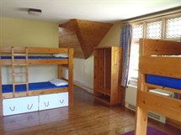
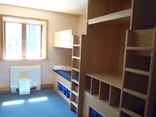
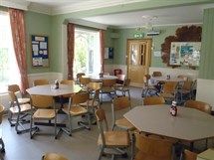
The accommodation
The sleeping accommodation is in dormitories and these vary in size from 4 to 12 beds. They are located on the first floor and this area is divided into two halves, one side for males and the other for females. The central area is for visiting staff with one of the staff bedrooms.
After a day of activities everyone comes back to the Centre for a hot shower and hearty meal of home cooked food. Your child will be well fed with plenty of tasty healthy food and will get enough rest, ensuring they have lots of energy to make the most of their visit.

Slide 5
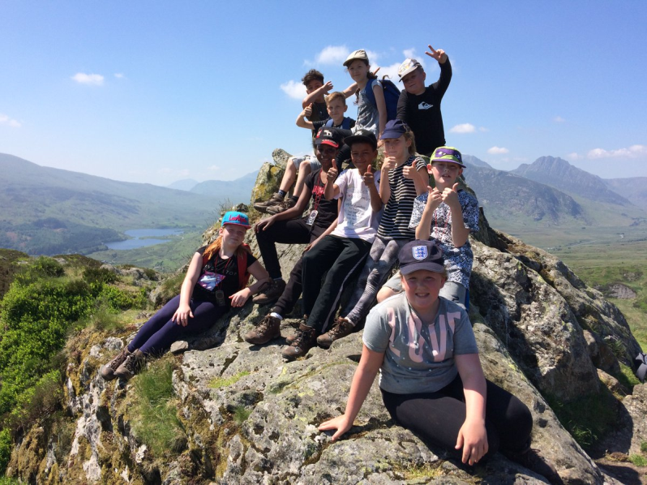
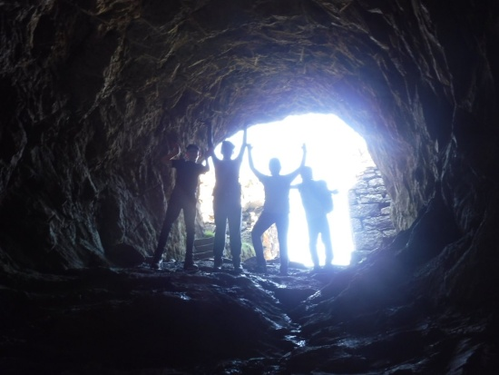
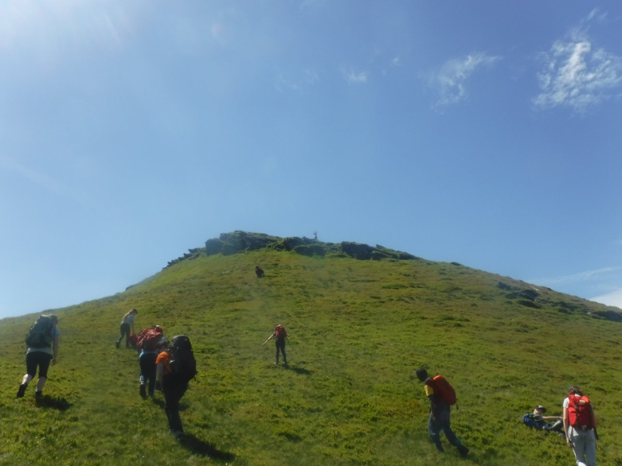
What to bring?
Hardwearing old clothes are best.
Children should not bring valuables or electronic devices – there are no keys for the bedrooms and we can’t guarantee that items won’t get broken. There’s no need to bring any computer games or mobile phones with them as the children be so busy having real adventures they won’t need them! Plus, there is very limited phone signal!
Everyone could, however, bring a magazine, books or puzzle books for first thing in the morning and last thing at night.
You are welcome to send a disposable camera with your child. Sticking a label on it and naming it would be a great help! Staff will also be taking photos during activities.
Luggage should be restricted to one large bag/holdall/trolley case, a sleeping bag and a bag/rucksack to carry on to the coach for the journey. Please name everything. A list of what has been packed, placed inside the bag, will help the children when packing to come home. Be prepared to unpack other children’s clothes, it happens every year!
The children are not to bring any snacks or sweet treats- we will be well fed!

Slide 6
Kit List for Children
Toiletries and a towel
No sprays – deodorant / body sprays / hair spray etc
Swimming costume
A sun hat in the summer
Plastic bin liner for wet and dirty clothes
Midge spray & sun cream (optional-summer only)
Camera (optional)
Torch (optional) Please note that clothes worn on the activities may get wet and muddy.
Children must be able to carry their own bag!
Lledr Hall will provide the following:
• Waterproof Jacket
• Waterproof Trousers
• Fleece Jumper
• Rucksack
• Walking Boots
• Any specialist equipment for the activities
Sleeping Bag
Pillowcase
Pyjamas
Slippers or indoor shoes
Outdoor shoes or trainers (old)
At least 2 pairs of tracksuit bottoms or
thick leggings - no jeans or heavy cotton
One t-shirt per day – must cover shoulders
At least two hoodies or sweatshirts
Comfortable clothes for the evening
Enough underwear for each day and a few extra
Enough socks for each day –
must be over the ankle (no trainer socks)
At least two pairs of thicker socks for
walking boots – must be over the ankle

Slide 7
Please put your child’s rolled up sleeping bag into a black bin liner and label it. It will come back 15 times the size it started out at!! Or put a black bin liner with a label on it in your child’s luggage to put it in at the end.
Pack some extra socks and thick sports socks are great! When the children get their walking boots they are always fitted when wearing two pairs of socks. Walking is much more comfortable and the risk of rubbing or blisters is reduced.
Each child is issued with a waterproof jacket, a fleece, waterproof trousers, walking boots and a rucksack. You don’t need to worry about providing any such equipment- the quality of the equipment is excellent.

Slide 8
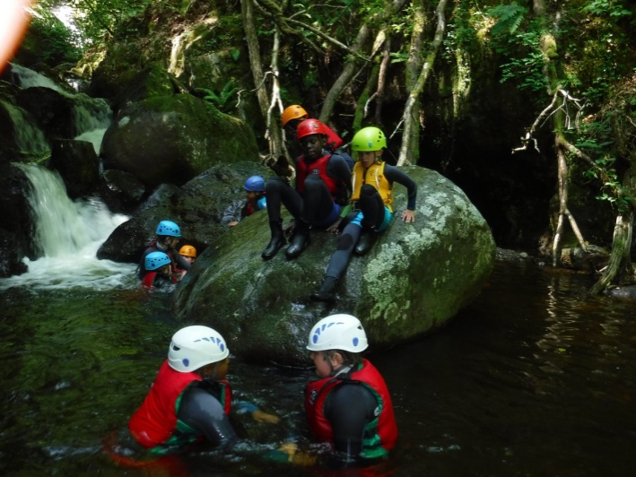
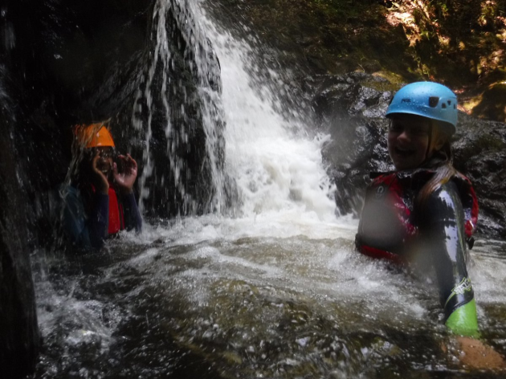
The food!
Breakfast
This is without doubt an important meal as it will fuel the children up for the morning activity.
Children have a choice of 4 types of cereal
They then have a hot meal e.g. beans on toast
Finally they can have as much toast as they like
Breakfast is served with tea or water
Lunch
After a busy morning the children are really ready for this. The twist is that they have made it themselves. After breakfast this is the first independent task of the day requiring them to think for themselves. They can have:
As many rolls/sandwiches made with fillings such as cheese, tuna, ham, sandwich spread etc. There is also salad to accompany their sandwich.
A packet of crisps
A packet of biscuits
A piece of fruit
A drink or more if they want it.
If the children are out for the day they take a packed lunch.

Slide 9
Dinner
Each meal begins with soup and as much bread as the children want. The main courses are delicious and consist of protein, carbohydrate and vegetables. Dessert follows that. Water is served with the meal.
Please inform us if your child has any specific dietary requirements.
Supper
After the evening activity there is always a bedtime drink and a freshly baked cake waiting for us.

Slide 10
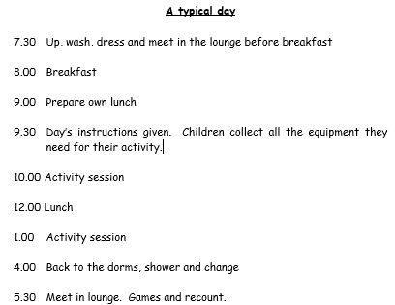
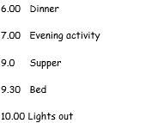

Slide 11
Activities
All sessions are agreed with the centre staff and are subject to change according to the weather and local conditions.
Activities we have completed in the past include:
Orienteering
Gorge walking
Rock climbing
Jungle gym
Canoeing
Abseiling
Mountain-biking
Mountain walking
Evening activities will include some of the following:
Team games
Sketching and painting
Torchlight walking
Nightline
Treasure hunt
Team quiz

Slide 12
Any questions?
On the final day, we will stop at a little village where children will have the opportunity to purchase a souvenir if they want. The children will not need more than £5 so please do not send them with any more.
If your child is travel sick please make sure they take a tablet in plenty of time and let the staff have any needed for the return journey.
Any medicines your child may need while they are away should be handed to the staff attending. You will need to complete an administration of medicines form authorising us to give your child any medication.

