Slide 1
Anxiety and Low Mood
Salford Educational Psychology Service
Coffee Morning
Joe Georgiou

Slide 2
Today’s Session
What is Anxiety?
What is Low Mood?
How can we help and support those experiencing anxiety/ low mood?

Slide 3
Issues to consider:
Wellbeing
Confidentiality
Notes:
Wellbeing - Many if not all of you will have direct experience or know of someone who has experienced difficulties regarding their emotional wellbeing. As we talk about today it might trigger some distressing feelings – please look after yourself – you are free to leave at any point and we are going to be around at the end if you would like to talk to one of us privately..
Likewise, we’d like this session to be interactive, so it’s important that we listen to each other and Respect different people’s views. Please respect confidentiality both when sharing information in the session, as we will not be able to talk about individual children or circumstances, just about anxiety generally. If people do share something personal to them, please don’t repeat this outside of the session as we want this to be a safe place for all.

Slide 4
Anxiety

Slide 5
What is Anxiety?
Anxiety is a word we use to describe feelings of unease, worry and fear. It incorporates both the emotions and the physical sensations we might experience when we are worried or nervous about something. Although we usually find it unpleasant, anxiety is related to the ‘fight or flight’ response – our normal biological reaction to feeling threatened
Source: Mind
“A state of apprehension and fear resulting from the anticipation of a threatening event or situation. In psychiatry, a patient has an anxiety disorder if normal psychological functioning is disrupted or if anxiety persists without an identifiable cause.”
Source: The American Heritage® Science Dictionary , 2005

Slide 6
What is Anxiety?
https://www.youtube.com/watch?v=dknTQktH5Z0
Notes:
https://www.youtube.com/watch?v=dknTQktH5Z0
HIGHLIGHT – Anna Freud Centre – lots of valuable resources around anxiety for schools/ to use with CYP -
Establish that most people feel anxious and stressed at some point and to varying degrees – it is a normal reaction to our bodies evolved to deal with stressful situations

Slide 7
Anxiety: What might a person experience?
What negative thoughts might the person be thinking?
What feelings might be experienced?
Feelings
Thoughts
Physical Sensations
Behaviour
What behaviour are you likely to see?
What bodily sensations might occur?
Notes:
Activity 5mins In pairs/groups take a couple of sections and think about the questions on the board

Slide 8
Anxiety: What might a person experience?
Scared
Agitated
Edgy
Everyone will laugh/stare at me
I’m going to fail
Something will go wrong
Irritable
Embarrassed
Nervous
Worried
I can’t do it
What if...
Intimidated
Feelings
Thoughts
I can’t breathe, I’m going to die
Alarmed
Unsure
Avoid leaving house/
going to school
Physical Sensations
Feeling sick
Behaviour
Raised blood pressure
Controlling and oppositional
Churning stomach
Stuttering, speech diffs.
Panic attack
Sweating
Hiding / missing lessons
Aggressive
Tense muscles
Fast heartbeat
Grinding teeth, biting lip, skin picking
Dry mouth
Blushing
Loss/gain in appetite
Quiet, withdrawn
Headaches, light headed, dizzy
Faster breathing
Notes:
5 mins to feedback
Answers come on in a clockwise order (starting with feelings -> Thoughts ->Physical Sensations ->Behaviour)
CBT perspective identifies links between thoughts, feelings, physical sensations and behaviours – hot cross bun model above shows some examples of what a YP who feels anxiety might experience – this can be related to school

Slide 9
Fight or flight – a normal healthy response to keep us safe
Breathing speeds up
Heart beats faster
Body sweats
Muscles tense
Butterflies in stomach
Mouth goes dry
Video clip: Fight Flight Freeze – Anxiety Explained For Teens - YouTube
Notes:
The Stress Response / Fight or Flight
What is stress?
We need stress to function properly in our daily lives. Our bodies are made to deal with dangerous situations like when, as early humans or cavemen, we were chased by wild animals. Today we don’t get chased by tigers very often but we do experiences stress for example the situations we’ve talked about today, and why we’re all here which is exams.
Stress is a natural physical and mental response to an emotional strain or suspense. The human body responds to events that provide stress (stressors) by activating the nervous system and specific hormones in the body. The hypothalamus, within the brain, signals the adrenal glands to produce the hormones adrenalin and cortisol, and to release these into the bloodstream. These hormones speed up a person’s heart rate, breathing rate, blood pressure and metabolism. The physical changes following the onset of a stressor prepare a person to react quickly and effectively to handle the pressure being experienced. This is known as the stress response.
When working effectively, the body’s stress response improves a person’s ability to perform well under pressure (Reach Out Australia, http://au.reachout.com/find/articles/stress#). When stress is a constant experience these chemicals build up and can have adverse effect on the body.

Slide 10
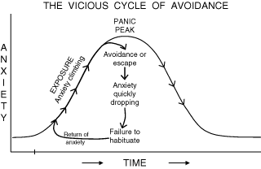
Notes:
Avoidance is a common response to situations or interactions that provoke a stress response. It is often referred to as an example of a ‘safety behaviour’. Avoidance or escape from a situation/interaction which we feel anxious about provides quick alleviation of stress, which is an attractive option, but when we then feel better we are reinforcing the idea that the trigger was something worthy of a stress response. Becomes a feedback loop.
As we can see in the diagram, avoidance / ‘escape’ is ultimately unhelpful– creates a vicious cycle through which young people do not develop stress tolerance (an understanding that they can manage anxious thoughts & feelings), or have the opportunity to ‘test’ whether their worries/anxiety about a situation are realised, meaning the trigger/situation continues to provoke the same (or a more intense) response over time.
Important to understand this to support someone who is anxious – both with avoidance and excessive reassurance, which will feed anxiety. Want to make child feel better and remove causes of distress. Ultimately, although well intended, it is not helping.

Slide 11
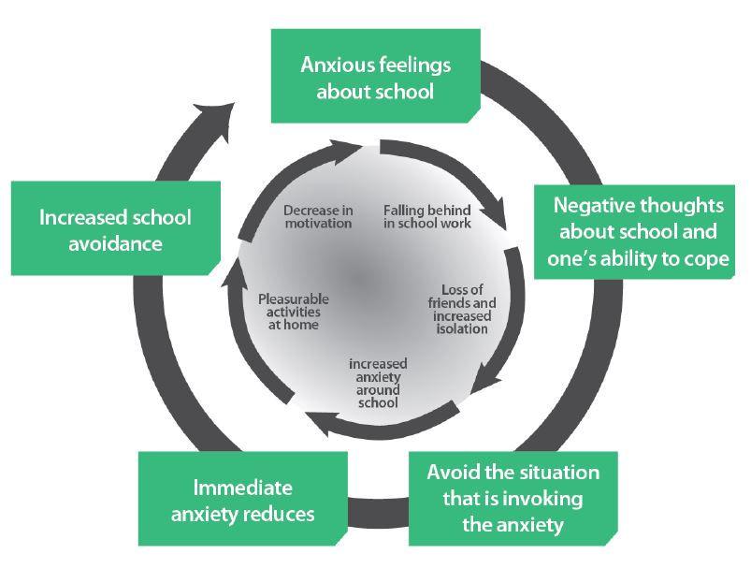
Emotionally Based
School Avoidance
(EBSA)
Emotional Barriers to School Attendance (EBSA) | Partners in Salford
Notes:
Anxiety is a key feature of EBSA – although a certain level of anxiety is a normal and adaptive response to keep us safe, if this becomes too heightened and is reinforced over time, it can negatively impact a YP’s school experiences and their day-to-day functioning.
YP experiences anxious feelings about school -> have negative thoughts about their ability to cope at school (e.g. “I can’t do the work”, “I have no friends”, “Who will look after mum whilst I’m at school?”), might also be experiencing physical symptoms of anxiety such as feeling sick, headache, sweating etc. which might start a few days before attending school or the night before ->so horrible and overwhelming to feel like this and think these fearful thoughts that the YP uses a coping strategy of avoiding the thing that invokes them (i.e. school avoidance) -> when the immediate threat is reduced, unsurprisingly the YP feels better which strengthens the idea that school is as bad as they thought especially when by avoiding it they don’t get the opportunity to challenge these beliefs -> over time, this cycle is repeated and the school avoidance becomes more entrenched.
At the same time, by missing school other factors can start to strengthen the negative thoughts about school and ability to cope there (e.g. falling behind with work, missing out on social opportunities) which increases anxiety and decreases motivation to break the cycle. Especially if this is supported by having enjoyable experiences of being at home/ not in school such as spending time with significant people and taking part in activities they enjoy more.

Slide 12
What impact has Covid-19 had on young people’s mental health?
A review of international studies showed an increase in depressive and anxious symptoms in children as a result of Covid-19. This is likely due to a wide range of factors, including:
social isolation;
anxiety about illness;
uncertainty about the future; and
strained familial relationships.
Lockdowns
Young Minds study highlighted the negative impact the closure of schools and universities would have on young people’s mental health. Concerns raised in their survey responses included:
loss of contact with friends;
concerns over whether exam grades would be negatively impacted; and
loss of everyday structure and routine.
Notes:
The charity YoungMinds conducted two studies looking at the impact of Covid-19 on young people with existing mental health needs.The first study was carried out over the first weekend of lockdownIn this study, 2,111 young people with existing mental health needs were surveyed between 20 March and 25 March.

Slide 13
What we might expect as ‘everyday anxiety’ response to recent stressors....
Tired – changes in sleep routines
Reassurance seeking
Separation anxieties – one last cuddle
Transition toys/objects
Peer difficulties, learning to share and compromise
Struggle with concentration, academic tasks
Worries about family and health
Irritable, emotionally dysregulated
Bereavement, feeling sad and upset
Uncertainty, increased fears about safety
Struggle to adapt to new environment
Delays in re-adjusting to environment (due to other needs e.g. ADHD/ASD)
Notes:
Not a surprise that some YP have found returning to school difficult after everything that has happened.. COVID-19 – stressful time for all. We recognise that there will be a wide range of 'normal' responses to the current situation and some pupils will just need support at the whole-school level.

Slide 14
Autism & Anxiety
Autism significantly increases the risk of anxiety.
7 in 10 autistic children have a mental health need.
2 in 5 autistic people are diagnosed with an anxiety disorder but many more will experience symptoms of anxiety that affect how they live their lives.
Anxiety disorders affect 42% of autistic children compared to 3% of children without autism.
Nason (2020) notes 7 types of anxiety frequently experienced by autistic children.
Sensory/information overload
Anxiety of uncertainty
Social anxiety
Performance anxiety
Anticipatory anxiety
Generalised anxiety
Separation anxiety
Notes:
The charity YoungMinds conducted two studies looking at the impact of Covid-19 on young people with existing mental health needs.The first study was carried out over the first weekend of lockdownIn this study, 2,111 young people with existing mental health needs were surveyed between 20 March and 25 March.
DGA- anxiety that is pervasive and not linked to a specific event. Seems to be apprehensive and insecure.

Slide 15
Anxiety - core approaches
Core Approaches
Try not to take over
Discourage avoidance
Provide time to talk and be open about feelings
Increase child’s coping skills by practicing calming strategies
Build confidence and independence in small steps
Promote physical activity
Predictable routines
Notes:
Provide time to talk:
Acknowledging YPs worries is an important first step.
Show you understand by acknowledging how your YP feels – about empathising rather than offering lots of reassurance
You can help YP recognise when they are feeling scared by naming the feelings “It sounds like you’re a bit worried about…” I wonder if you’re feeling a bit scared?
Labelling worries in this way helps YP to see that feeling scared is a normal feeling that can be managed.
LINK TO EMOTION COACHING TRAINING
Increase YP’s helpful coping skills:
Anxious feelings are fed by anxious thinking. Important not to dismiss Yps anxious feelings but to help them see that the situations they are worried about may not be as bad as they think. Prepare YP for situations they may find scary by planning ahead and practising ideas about what to do. YP don’t learn when they are already fearful because fear makes it hard for them to remember what you are saying. Preparation and practice help them use their coping skills and see they can manage
Discourage avoidance:
When we feel anxious about something we naturally try and avoid it. But in doing so we feed the anxiety and make it greater and stronger the next time were faced with a similar situation. WE can help the YP to face things in a more manageable way by talking through situations, what they expect, what they can do, and the steps they can take to achieving this. We want to help but need to mindful that we don’t push too hard, as this would create an unpleasant and overwhelming experience rather than success. Praise or reward for every step they manage to take.
Avoid taking over:
When we see a YP feeling anxious, we naturally want to help and can have a tendency to take over at times. YP with anxiety are often happy to let someone else do things for them, but this stops them from learning how to cope for themselves.
Build confidence in small steps:
Feeling pressure to be perfect is common in YP with anxiety disorders
We know successes build confidence so setting realistic expectations and helping them set their own goals is important in helping them to learn how to manage their anxiety.
Set small challenges they can quickly succeed at and build gradually becoming more independent. Provide opportunities for YP to take on special responsibilities that help support their view of themselves as capable. Reduces need for reassurance and builds confidence.

Slide 16
Low Mood

Slide 17
What is Low Mood?
Notes:
Discussion 3 mins

Slide 18
What is Low Mood?
A low mood is a temporary feeling of sadness or unhappiness that everyone experiences every now and then. It's normal to feel down occasionally, particularly when you’re stressed or going through personal challenges, or disappointments.
A low mood usually only lasts for a short period of time and can usually be linked to a specific event or situation. Crucially, for it to be defined a low mood (as opposed depression), your feelings of sadness will soon pass.
Common causes of low mood can include:
Stressful life events, such as job loss, relationship difficulties, or bereavement
Chronic illness or pain
Sleep disturbances or insomnia
Nutritional deficiencies, such as low vitamin D or B12 levels
Side effects of certain medications
Hormonal imbalances or changes, including premenstrual syndrome (PMS) or menopause

Slide 19
Signs/ symptoms
Sadness
Anxiety/ panic
being ‘moody’ and irritable
not being interested in things they used to enjoy
not wanting to go to school or go out
often feeling tired or exhausted
becoming withdrawn and isolating self from others
feeling unhappy and miserable or becoming tearful
sleep problems or sleeping a lot
changes in appetite
feeling hopeless and/or worthless
angry or frustrated
low on confidence or self-esteem/ being self-critical

Slide 20
Video: The ‘Vicious Cycle’ of Low Mood
Notes:
VIDEO - https://www.youtube.com/watch?v=wXCeYgHLJdo

Slide 21
Low Mood or Depression
A low mood often gets better after a few days or weeks.
It's usually possible to improve a low mood by making small changes in your life. For example, resolving something that's bothering you or getting more sleep.
May be in response to a specific event (e.g. argument with friends, bereavement, stressful life event).
NHS UK: If you have a low mood that lasts 2 weeks or more, it could be a sign of depression.
Symptoms are generally more severe and persistent.
Other symptoms of depression may include:
not getting any enjoyment out of life
feeling hopeless
not being able to concentrate on everyday things
having suicidal thoughts or thoughts about harming yourself
Both can be associated with feelings of anxiety

Slide 22
Unhelpful Thinking Styles
Black and White Thinking “If it’s not perfect, I’m a failure”
Jumping to Conclusions “I haven’t heard from Sarah in a while, she must be upset with me”
Catastrophising “I made a mistake today – I’m going to fail all my exams”
Overgeneralising “ I always say the wrong thing” “I’m never going to be able to do it”
‘Should-ing’ and ‘Must-ing’ “I should go to that part tonight; I must be a good friend”
Notes:
Watch out for these!

Slide 23
Responding to Low Mood
Core Approaches
Encourage daily activities that support wellbeing
Encourage reflection on enjoyable activities
Provide time to talk and be open about feelings
Support child to identify people in their ‘support circle’
Co create a ‘support plan’ incorporating small achievable targets
Provide reassurance
Listen and provide emotional support
Notes:
Provide time to talk and be open about feelings – recognise that the young person might not feel ready to talk when you first approach them, continue to gently try and encourage them to talk to you (or another trusted adult) about how they are feeling. They may also feel more comfortable to talk to an anonymous person or helpline/ chat function (e.g’s on signposting slide)
Listen and provide emotional support – Providing a space for CYP to feel heard is powerful. Try not to ask too many questions, come up with quick solutions or gloss over their sadness. Empathise with how they’re feeling and remember they’ve taken a risk in opening up to you – let them know they can talk to you as often and for as long as they need to.
Support child to identify people in their ‘support circle’ – who they can seek wider support from. They might even want to keep a list of the people they trust and can reach out to for support when they need it, together with their contact details. Doing this exercise can help your child to feel less isolated, reminding them that there are people in their life who care about them.
Encourage reflection on enjoyable activities - Take a step-by-step approach towards helping them do these activities when they feel able to. This could be things like exercising or playing sport, listening to music, doing something creative like colouring or drawing, watching a favourite film, reading a favourite book or going for a walk with you.
Encourage daily activities that support wellbeing - This includes getting up at a regular time, eating regular healthy meals, doing exercise, drinking water, spending quality time with loved ones and getting enough sleep (teens need a minimum of eight to ten hours per night). It might help to think about limits around screen time as part of this. (Idea of pro-active strategies being more helpful than reactive ones)
Co create a ‘support plan’ incorporating small achievable targets – Together you can explore things like the type of support they would find helpful from you and others, the activities that help them to feel better and the people or services they can get in touch with when they need support.
Provide reassurance- let them know you care for them, these feelings won’t last forever, and that you can find support to help things feel better.
https://www.youngminds.org.uk/parent/parents-a-z-mental-health-guide/depression-and-low-mood/

Slide 24
Managing Risk/ Seeking further help
If the situation isn’t getting better with time and you’re feeling worried about a child’s mental health, seek professional support and advice.
Many children and young people will need professional, and specialist help to feel better if they are experiencing depression.
Young people who are struggling with depression can experience feelings of not being able to go on, or no longer wanting to be alive. This can lead them to think about, speak of, or attempt suicide.
A young person can struggle with thoughts of suicide without acting on them. But these thoughts can also develop into stronger feelings, and a plan or intention to attempt suicide. All suicidal thoughts should be taken seriously, and young people going through this need help and support.

Slide 25
Adult Wellbeing

Slide 26
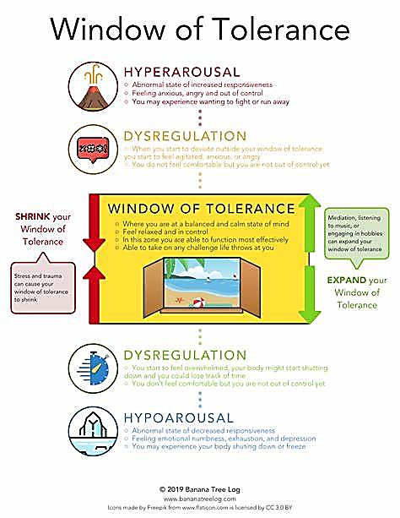
Window of Tolerance

Slide 27
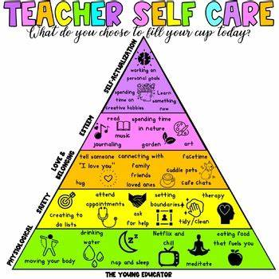
Hierarchy of Needs
Notes:
Adult Hierarchy of Needs – Based on Maslow.

Slide 28
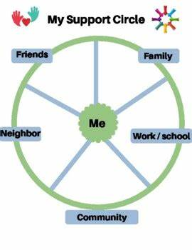
Support Network
Notes:
Specific to each setting.
Informal is as important as formal support.

Slide 29
Resources
Early Help - Early help for families • Salford City Council
Health improvement service - Wellbeing and welfare • Salford City Council
Greater Manchester Hub – mental health and Covid resources https://hub.gmhsc.org.uk/mental-health/covid-19-mental-health-and-wellbeing-resources/
Young Minds Charity – resources and advice
Helping Your Child With Anxiety (youngminds.org.uk)
Anxiety UK – help line and information- Anxiety UK - National charity helping people with Anxiety
CAMHS resources - https://www.camhs-resources.co.uk/
Anna Freud Centre – resources and advice https://www.annafreud.org/resources/schools-and-colleges/lets-talk-about-anxiety-animation-and-teacher-toolkit/
Resource hub : Mentally Healthy Schools
MindEd – understanding the difference between low mood and depression https://www.minded.org.uk/Component/Details/445667

Slide 30
Signposting
Shout 85258 https://giveusashout.org text helpline
childline.org.uk | 0800 1111 (free 24hr) confidential listening
samaritans.org | 116 123 (free 24 hr)| jo@samaritans.org confidential listening
studentsagainstdepression.org resources to move away from depression
youngminds.org.uk mental health info and guidance
youthaccess.org.uk young people’s info, advice and counselling
themix.org.uk essential support for under 25s
Notes:
Anna

Slide 31
Thank you!
Any Questions?

